Slide 1

Set Theory

Slide 2
Set Basics
Examination [5]
1. What is Set?
2. State whether the sets in each pair are equal or not.
a) {a, b, c, d} and {a, c, d, b}
b) {2, 4, 6} and {x | x is an even number}

Slide 3
Set Basics
Definition
A set is an unordered collection of objects, called elements or members of the set. A set is said to contain its elements.
Example
People in a class: {Trisha, Tanvir, Tonmoy, Keya}
Districts in the BD : {Rajshahi, Dhaka, Nator, … }
Sets can contain non-related elements: {3, a, Potato}
All positive numbers less than or equal to 5: {1, 2, 3, 4, 5}

Slide 4
Set Basics
Definition
A set is an unordered collection of objects, called elements or members of the set. A set is said to contain its elements.
We write a ∈ Ato denote that a is an element of the set A. ($∈$ = belongs to)
The notation a ∈ A denotes that a is not an element of the set A. ( $∉ =not belongs to)$
It is common for SETS to be denoted using uppercase letters.
Lowercase letters are usually used to denote elements of sets.

Slide 5
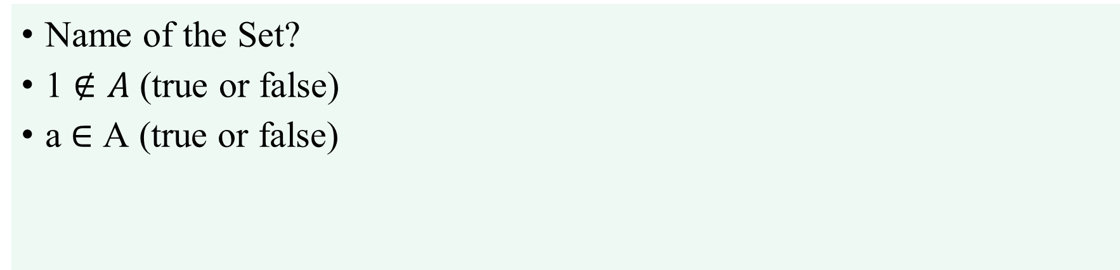
Set and Elements
Let, A = { 1, a, e, u, i, o, 2, 3}
Name of the Set?
1 $∉A$ (true or false)
a $∈$ A (true or false)

Slide 6
How to describe a Set?
Three popular methods
Word description
Set of even counting numbers less than 10
2. The listing method / Roster method
{2, 4, 6, 8}
3. Set-builder notation
{x | x is an even counting number less than 10}

Slide 7
How to describe a Set?
Word description
Make a word description of the set.

Slide 8
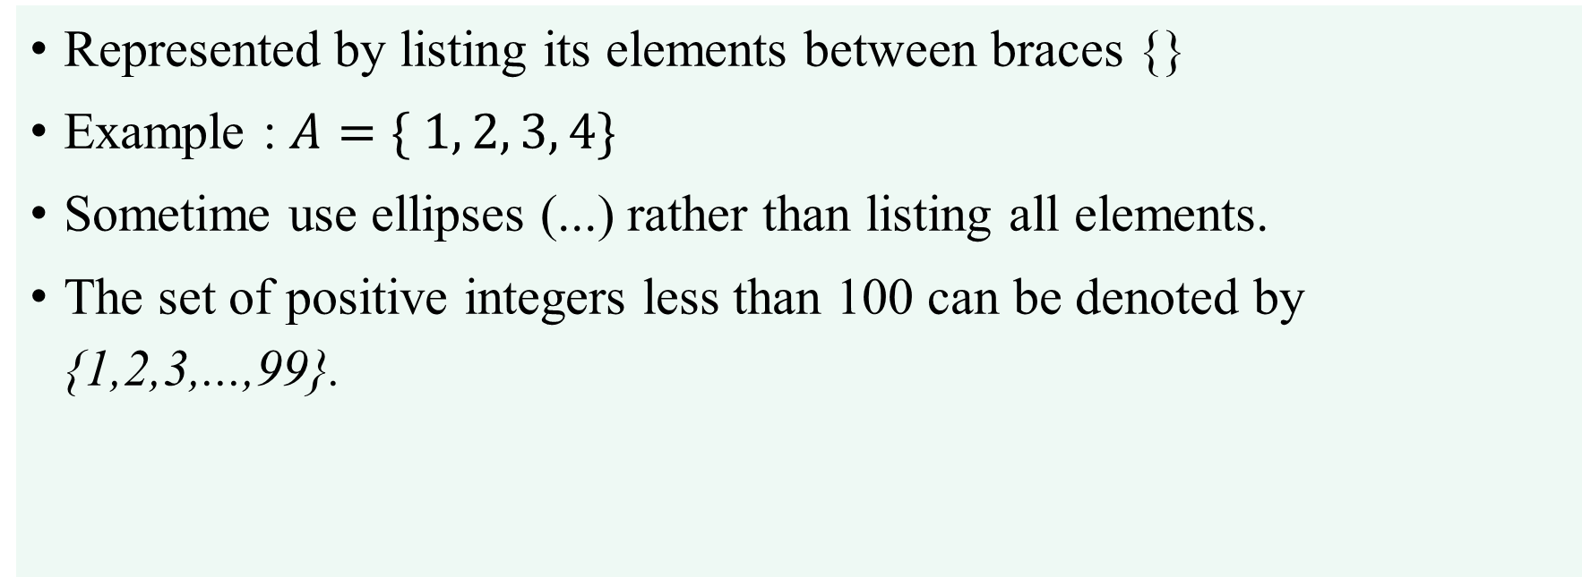
How to describe a Set?
2. Roster Method
Represented by listing its elements between braces {}
Example : $A=\{ 1, 2, 3, 4\}$
Sometime use ellipses (...) rather than listing all elements.
The set of positive integers less than 100 can be denoted by {1,2,3,...,99}.

Slide 9
How to describe a Set?
3. Set-builder notation
characterize all elements in the set by stating the property or properties they must have to be members.
the set O of all odd positive integers less than 10 can be written as
O = { x | x is an odd positive integer less than 10 }
O = { x ∈ Z⁺ | x is odd and x < 10 }
Example: B = {x | x is an even integer, x > 0}
Read as- “B is the set of x such that x is an even integer and x is greater than 0”
“|” is read as “such that” and “,” as “and”.

Slide 10
How to describe a Set?
3. Set-builder notation with interval
the notation for intervals of real numbers. When a and b are real numbers with a < b, we write
[a, b] = {x | a ≤ x ≤ b}
[a, b) = {x | a ≤ x < b}
(a, b] = {x | a < x ≤ b}
(a, b) = {x | a < x < b}
Note that [a, b] is called the closed interval from a to b and (a, b) is called the open interval from a to b.

Slide 11
Often used sets
N = {0, 1, 2, 3, …} is the set of natural numbers
Z = {…, -2, -1, 0, 1, 2, …} is the set of integers
Z⁺ = {1, 2, 3, …} is the set of positive integers (a.k.a whole numbers)
Note that people disagree on the exact definitions of whole numbers and natural numbers
Q = {p/q | p ∈ Z, q ∈ Z, q ≠ 0} is the set of rational numbers
Any number that can be expressed as a fraction of two integers (where the bottom one is not zero)
R is the set of real numbers
R⁺ the set of positive real numbers
C the set of complex numbers.

Slide 12

Specifying Sets (cont.)
Specifying Set
A = {a, e, i, o, u}
B = {x | x is an even integer, x > 0}
E = {x | $x^{2}−3x+2=0$}
A = {x | x is a letter in English, x is a vowel}
B = {2, 4, 6, …….}
E = {1, 2}

Slide 13
Specifying Sets (cont.)
Specifying Set
A = {x: x ∈ Z, x is even, x <15 }
B = {x: x ∈ Z, x + 4 = 3 }
C = {x: x ∈ Z, x² + 2 = 6 }
A = {… -8, -6, -4, -2, 0, 2, 4, …., 14}
B = {-1}
E = {-2, +2}

Slide 14
Set - properties
Order does not matter
{1, 2, 3, 4, 5} is equivalent to {3, 5, 2, 4, 1}
Frequency does not matter
- Consider the list of students in this class
It does not make sense to list somebody twice

Slide 15
Set Terminology : The universal set
Definition
U is the universal set – the set of all of elements (or the “universe”) from which given any set is drawn
For the set {-2, 0.4, 2}, U would be the real numbers
For the set {0, 1, 2}, U could be the N, Z, Q, R depending on the context
For the set of the vowels of the alphabet, U would be all the letters of the alphabet

Slide 16
Set Terminology : The Empty Set
Definition
If a set has zero elements, it is called the empty (or null) set
Written using the symbol ∅
Thus, ∅ = { } ← VERY IMPORTANT
It can be a element of other sets
{ ∅, 1, 2, 3, x } is a valid set
∅ ≠ { ∅ }
The first is a set of zero elements
The second is a set of 1 element [A set with one element is called a singleton set]

Slide 17
Venn diagrams
Represents sets graphically
The box represents the universal set
Circles represent the set(s)
Consider set S, which is the set of all vowels in the alphabet
The individual elements are usually not written in a Venn diagram
b
c
d
f
U
g
h
j
S
k
l
m
n
p
q
a
e
i
r
s
t
o
u
v
w
x
y
z

Slide 18
Set Terminology : Subset
Definition
The set A is a sub set of B if and only if every element of A is also an element of B.
We use the notation A ⊆ B to indicate that A is a subset of the set B.
We see that A ⊆ B if and only if the quantification ∀x (x∈ A → x ∈ B) is true

Slide 19
Set Terminology : Subset
Example
If A = {2, 4, 6} and B = {1, 2, 3, 4, 5, 6, 7}; A is a subset of B
If A = {1, 2, 3, 4} and B = {1, 2, 3, 4}; A is a subset of B
Every nonempty set S has at least two subset
For any set S, S ⊆ S (∀S S ⊆ S)
For any set S, ∅ ⊆ S (∀S ∅ ⊆ S)

Slide 20
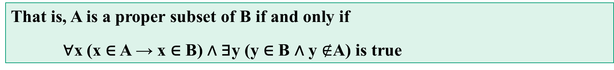
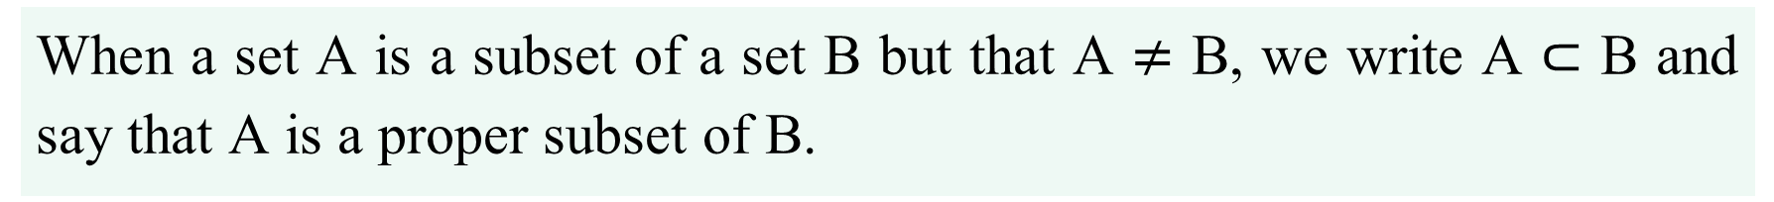
Set Terminology : Proper Subset
Definition
When a set A is a subset of a set B but that A $≠$ B, we write A ⊂ B and say that A is a proper subset of B.
For A ⊂ B to be true, it must be the case that A ⊆ B and there must exist an element y of B that is not an element of A.
That is, A is a proper subset of B if and only if
∀x (x ∈ A → x ∈ B) ∧ ∃y (y ∈ B ∧ y $∉$A) is true

Slide 21
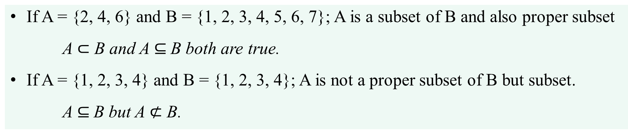
Set Terminology : Proper Subset
Example
If A = {2, 4, 6} and B = {1, 2, 3, 4, 5, 6, 7}; A is a subset of B and also proper subset
A $⊂$ B and A $⊆$B both are true.
If A = {1, 2, 3, 4} and B = {1, 2, 3, 4}; A is not a proper subset of B but subset.
A $⊆$B but A $⊄$ B.

Slide 22
Set Terminology : Set Equality
Definition
Two sets are equal if and only if they have the same elements. We write A = B if A and B are equal sets.
Therefore, if A and B are sets, then A and B are equal if and only if
∀x (x ∈ A ↔ x ∈ B)

Slide 23
Set Terminology : Set Equality
Example
Let two sets A = {1, 2, 3} and B = {3, 2, 1}
then A = B (true or false?)
Let two sets A = {1, 2, 3} and B = {3, 3, 2, 1, 2, 1}
then A = B (true or false?)
A = {x: x is an odd positive integer less than 10}
B = {1, 3, 5, 7, 9}
A = B ?

Slide 24
Set Terminology : Set Cardinality
Definition
Let S be a set. If there are exactly n distinct elements in S where n is a nonnegative integer, we say that S is a finite set and that n is the cardinality of S. The cardinality of S is denoted by |S|.
The term cardinality comes from the common usage of the term cardinal number as
the size of a finite set.

Slide 25
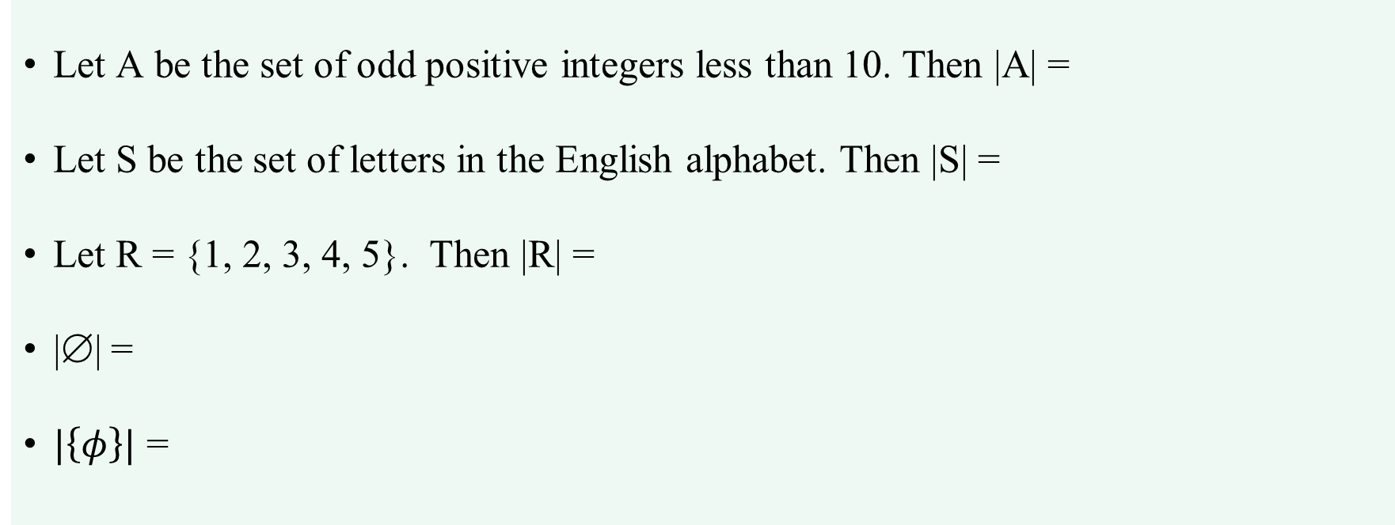
Set Terminology : Set Cardinality
Example
Let A be the set of odd positive integers less than 10. Then |A| =
Let S be the set of letters in the English alphabet. Then |S| =
Let R = {1, 2, 3, 4, 5}. Then |R| =
|∅| =
$|\left\{φ\right\}|$ =
5.
26
5.
0
1

Slide 26
Set Terminology : Finite Set and Infinite Set
Definition : Finite Set
Let S be a set. If there are exactly n distinct elements in S where n is a nonnegative integer, we say that S is a finite set
R = {1, 2, 3, 4, 5} finite set
Definition : Infinite Set
A set is said to be infinite if it is not finite.
The set of positive integers is infinite.

Slide 27
Set Terminology : Power Set
Definition
Given a set S, the power set of S is the set of all subsets of the set S. The power set of S is denoted by P(S).
What is the power set of the set {0,1,2}?
What is the power set of the empty set?
What is the power set of the set{∅}?

Slide 28
Set Terminology : Cartesian Product
Definition
Let A and B be sets. The Cartesian product of A and B, denoted by A x B, is the set of all ordered pairs (a, b) where a ∈ A and b ∈B.
Hence A×B = {(a, b) | a ∈ A ∧ b ∈ B}.
Let, A = {1, 2} and b = {a, b, c}
A x B = {(1, a), (1, b), (1, c), (2, a), (2, b), (2, c)}
B x A = ?

Slide 29
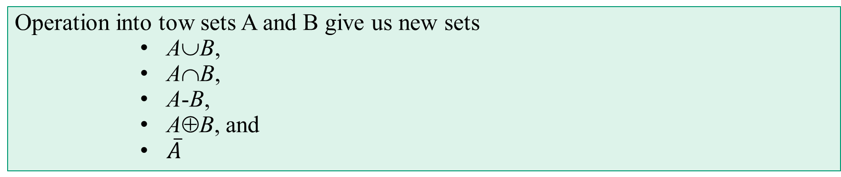
Set Operation
Operations
Union (∪)
Intersection (∩)
Difference (−)
Complement (“—”)
Symmetric Difference (⊕)
Operation into tow sets A and B give us new sets
A∪B,
A∩B,
A-B,
A⊕B, and
$\overline{A}$

Slide 30
Set Operation : Union
Definition
Let A and B be sets. The union of the sets A and B, denoted by A ∪ B, is the set that contains those elements that are either in A or in B, or in both.
A U B = { x | x∈ A $∨$x∈ B }
A = {1, 2, 5, 7}, B = {3, 4, 5, 6}
A U B =
{ 1, 2, 3, 4, 5, 6, 7}

Slide 31
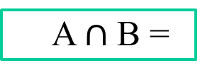
Set Operation : Intersection
Definition
Let A and B be sets. The intersection of the sets A and B, denoted by A∩B, is the set containing those elements in both A and B.
A $∩$B = { x | x∈ A $∧$x∈ B }
A = {1, 2, 5, 7}, B = {3, 4, 5, 6}
A $∩$B =
{ 5 }

Slide 32
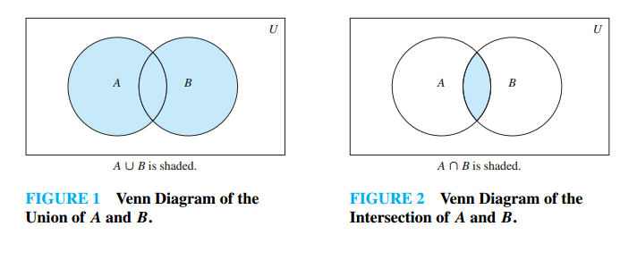
Union and Intersection in VD

Slide 33
Set Operation : Union and Intersection
Examples
A = {1, 2, 3, 4}, B = {3, 4, 5, 6, 7}, C = {2, 3, 5, 7}
A U B = ?
A U C = ?
A ∩ B = ?
B ∩ C = ?

Slide 34
Disjoint Sets
Definition
Two sets are called disjoint if their intersection is the empty set.
i.e. A ∩ B = ∅ .
{a, b} and {3, 4} are disjoint
U
A
B

Slide 35
Disjoint Union
Definition
When A and B are disjoint, the disjoint union operation is well defined. The circle above the union symbol indicates disjointedness.
U
A
B

Slide 36
Set Operation : principle of inclusion–exclusion

Slide 37
Set Operation : Difference
Definition
Let A and B be sets. The difference of A and B, denoted by A−B, is the set containing those elements that are in A but not in B. The difference of A and B is also called the complement of B with respect to A.
A − B = { x | x ∈ A ∧ x $∉$ B}
The difference of A and B is also called the complement of B with respect to A.
The difference of sets A and B is sometimes denoted by A \ B.

Slide 38
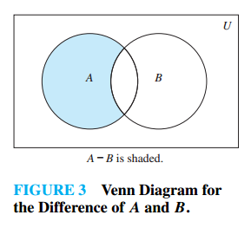
Set Operation : Difference
Example
Let A = {1, 3, 5}, B = {1, 2, 3}
A – B = {5}
Let A = {1, 3, 5, 6}, B = {1, 2, 3,9,10}
A – B = {5, 6}

Slide 39
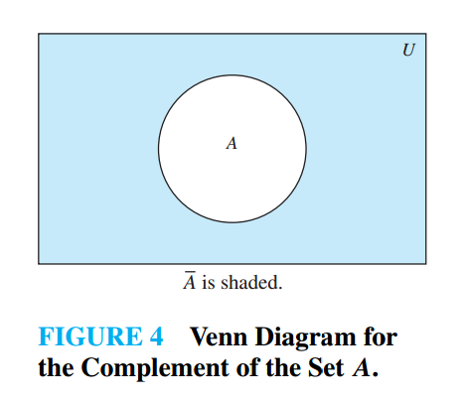
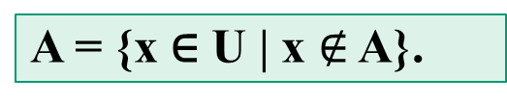
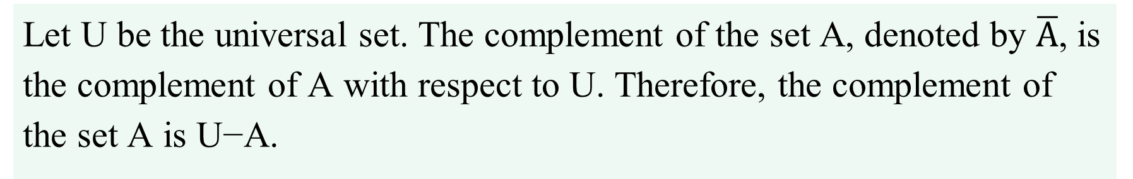
Set Operation : Complement
Definition
Let U be the universal set. The complement of the set A, denoted by $\overline{A}$, is the complement of A with respect to U. Therefore, the complement of the set A is U−A.
A = {x ∈ U | x $∉$ A}.

Slide 40
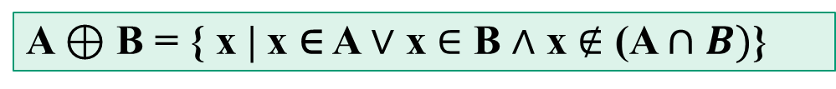
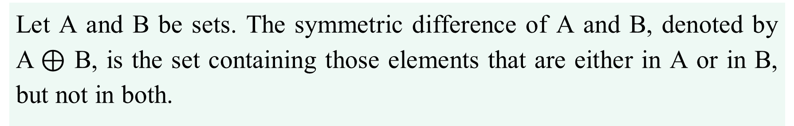
Set Operation : Symmetric Difference
Definition
Let A and B be sets. The symmetric difference of A and B, denoted by A$⊕$ B, is the set containing those elements that are either in A or in B, but not in both.
A⊕B
U
A $⊕$ B = { x | x ∈ A $∨$ x $∈$ B $∧$ x $∉$ (A $∩B)$}
A
B

Slide 41
How to Prove a Set identities
Five Methods
Use the basic set identities
Use membership tables
Prove each set is a subset of each other
Use set builder notation and logical equivalences
Use Venn Diagram

Slide 42
Set identities
A∪∅ = A A∩U = A | Identity Law | A∪U = U A∩∅ = ∅ | Domination law
A∪A = A A∩A = A | Idempotent Law | (A^{c})^{c} = A | Complement Law
A∪B = B∪A A∩B = B∩A | Commutative Law | (A∪B)^{c} = A^{c} ∩ B^{c} (A∩B)^{c} = A^{c} ∪ B^{c} | De Morgan’s Law
A∪(B∪C) = (A∪B)∪C A∩(B∩C) = (A∩B)∩C | Associative Law | A∩(B∪C) = (A∩B)∪(A∩C) A∪(B∩C) = (A∪B)∩(A∪C) | Distributive Law
A∪(A∩B) = A A∩(A∪B) = A | Absorption Law | A ∪ A^{c} = U A ∩ A^{c} = ∅ | Complement Law

Slide 43
Set identities: (A ∪ B ) ∪ C = A ∪ (B ∪ C )
Using set definition and set builder notation
Proof : (A∪B )∪C = {x | x ∈ A ∪B ∨ x ∈ C } (by def.)
= {x | (x ∈ A ∨ x ∈ B ) ∨ x ∈ C } (by def.)
= {x | x ∈ A ∨ ( x ∈ B ∨ x ∈ C ) } (logical assoc.)
= {x | x ∈ A ∨ (x ∈ B ∪ C ) } (by def.)
= A∪(B ∪C ) (by def.)


Slide 44
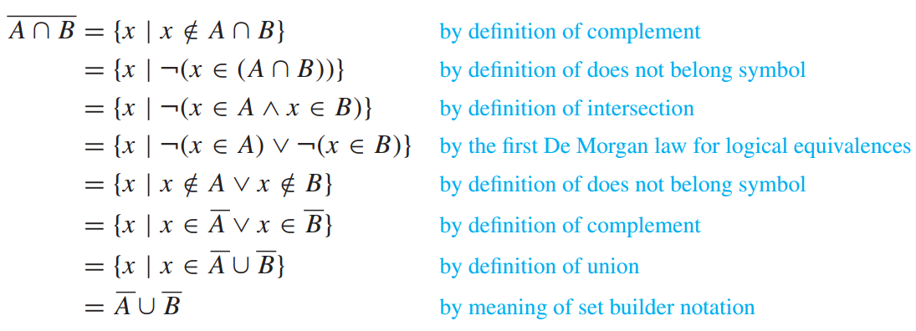

Set identities $\overline{A∩B}$=$\overline{A}$∪$\overline{B}$
Use set builder notation and logical equivalences

Slide 45
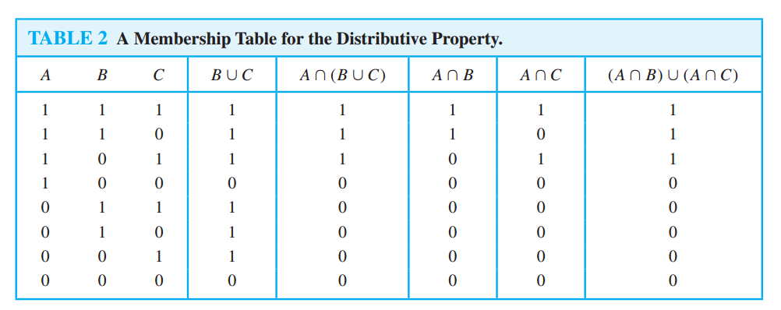
Set identities : A ∩ (B∪C) = (A∩B) ∪ (A∩C)
Use a membership table

Slide 46
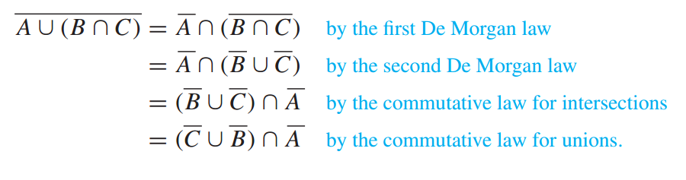

Set identities $\overline{A∪\left(B∩C\right)}$ = ($\overline{C}$∪$\overline{B}$) $∩$$\overline{A}$
Use set identity law

Slide 47
Set Identities via Venn
It’s often simpler to understand an identity by drawing a Venn Diagram.
For example DeMorgan’s first law
can be visualized as follows.

Slide 48
Visual DeMorgan
A:
B:

Slide 49
Visual DeMorgan
A:
B:
A∪B :

Slide 50
Visual DeMorgan
A:
B:

Slide 51
Visual DeMorgan
A:
B:
‾A:
‾B:

Slide 52
Visual DeMorgan
A:
B:
‾A:
‾B:

Slide 53
Visual DeMorgan
=

